Slide 1
ArSL Recognizer
P R O J E C T
Presented by: Mohamed Tamer – Menna Samir

Slide 2
CONTENT OF THE PROJECT
We’re going to discuss our project through some bullet points, which are:
A brief about the idea of the project
The Preprocessing process.
Model Training.
Model Evalution.

Slide 3
WHOA!
Hi everybody! This is Mohamed and my partner Menna. We’re two students who are so ambitious with ML & AI stuff, seeking for self-development and always being up-to-date, looking forward in one day to be professional ML engineers and build integrated AI tools that would compete with giants like chatgpt and copilot.
And we’re more than happy to introduce this project as a decent part of this journey!

Slide 4
“An ounce of practice is worth more than tons of preaching. ”
—Mahatma Gandhi

Slide 5
01
INTRODUCTION

Slide 6
INTRO
Have you ever imagined what life would be like if you couldn’t hear a single sound — not a song, not a voice, not even your own name?
There are over 466 million people worldwide with disabling hearing loss.
Only in Egypt, hundreds of thousands are facing this issue
For most of us, communication is effortless. But for the deaf and hard-of-hearing community, expressing a simple idea can sometimes be a major challenge — especially when there’s a lack of widespread understanding or tools to help.
That’s exactly why we chose to work on this project: to build an Arabic Sign Language recognizer — a tool that uses machine learning to bridge the gap between spoken and signed language, and make communication more inclusive.

Slide 7
TO PERFORM SUCH A TASK, IT’S DIVIDED INTO THREE MAIN TASKS:
PREPROCESSING
MODEL TRAINING
EVALUTION
It’s about loading the dataset we wanna manipulate, performing some EDA, having a neat and ready information as an output
It’s about testing more than model or algorithms, comparing the performance of ech of them, and using the best at the end of the day
It’s about usinng some methods such as Grid Search, Cross Validation ,

Slide 8
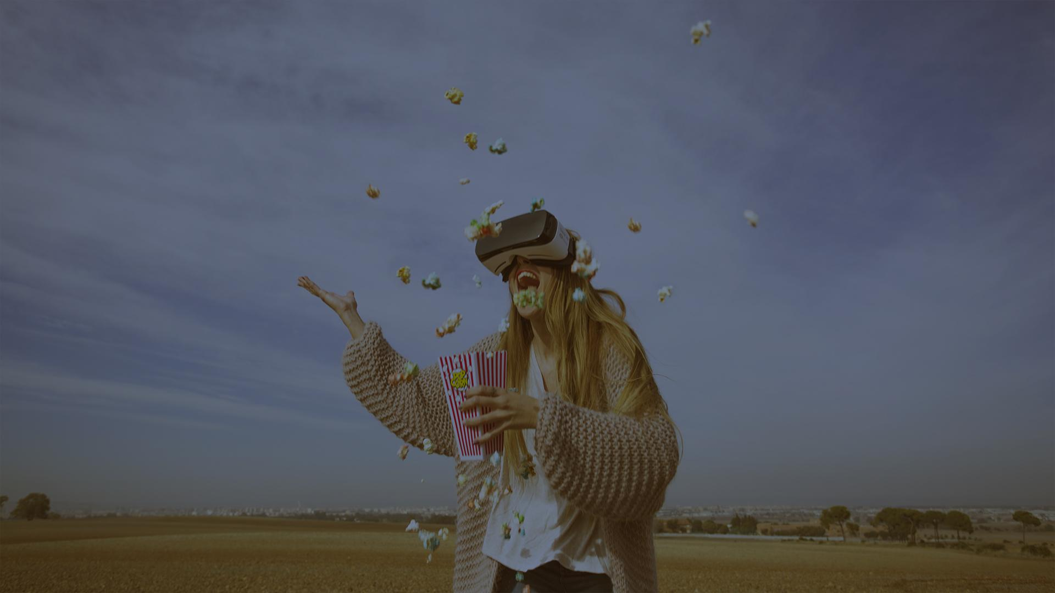
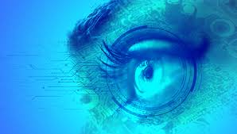
IMAGE PREPROCESSING

Slide 9
PREPROCESSING
When it comes to preprocessing process, it’s about a couple of tasks to perform, starting from loading the images , EDA untill preparing the data to enter the training phase. This was performed through some certain step which are:
Grayscale Conversion: Transformed all RGB images to grayscale to reduce computational load and focus on shape and contour features instead of color.
Normalization: Scaled pixel values from the original 0–255 range to 0–1 using min-max normalization, which helps improve model performance and training stability.
Image Resizing: Ensured all images were uniformly resized to 64×64 pixels to maintain consistency across the dataset and avoid shape mismatch errors.

Slide 10
PREPROCESSING
Flattening: Converted 2D image arrays into 1D feature vectors to make them compatible with classic ML algorithms like Random Forest a
Data Cleaning: Inspected the dataset for any corrupted, unreadable, or mislabeled files and removed them to maintain data integrity.
Label Encoding:
Converts categorical Arabic letters into numerical labels suitable for model training.

Slide 11
PREPROCESSING
Train-Test Split:
Divides the dataset into training and testing subsets (70% train, 30% test).
Feature Scaling:
Uses StandardScaler to normalize pixel values, ensuring better performance in distance-based models and PCA.
Dimensionality Reduction (PCA):
Applies Principal Component Analysis to retain 95% of the variance while reducing the number of features, which helps speed up training and may improve accuracy.

Slide 12
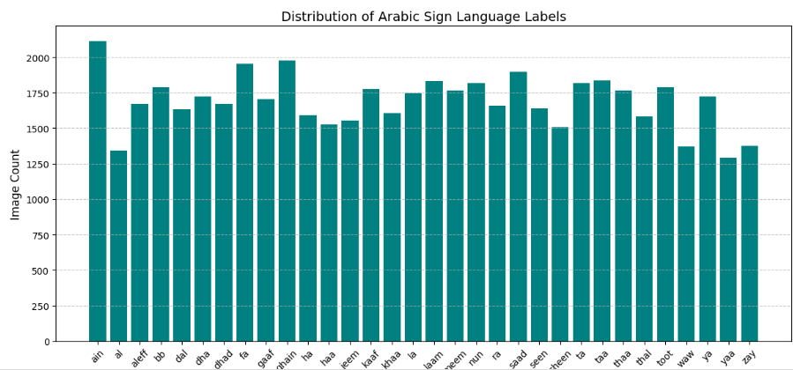
PREPROCESSING
Data visualizations:
Utilizing graphs and visualization methods helps in figuring out the trending events in the data so we know exactly how to deal with.
We used plenty of methods such as:
Bar plots to study the data distribution and fix any bias or imbalance

Slide 13
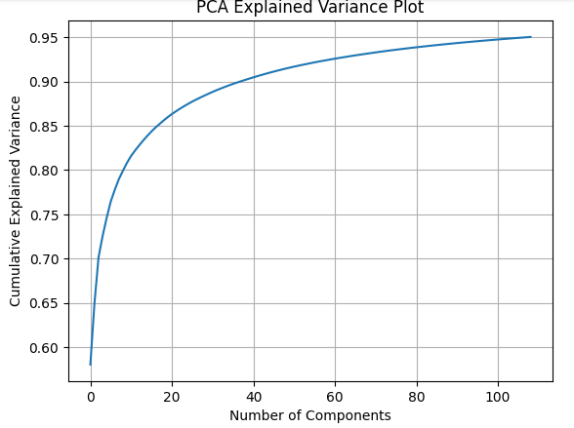
PREPROCESSING
Data visualizations:
Utilizing graphs and visualization methods helps in figuring out the trending events in the data so we know exactly how to deal with.
We used plenty of methods such as:
The curve plot shows how much information (variance) we keep as we add more PCA components.

Slide 14
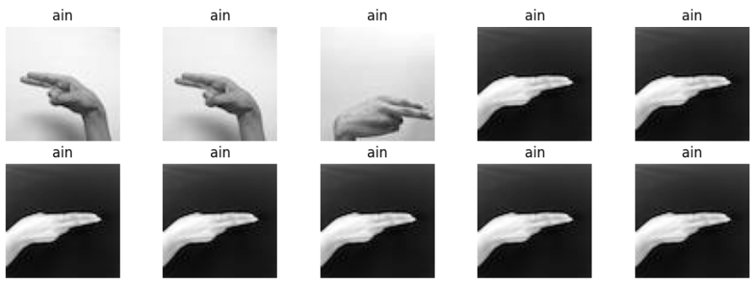
PREPROCESSING
Data visualizations:
Utilizing graphs and visualization methods helps in figuring out the trending events in the data so we know exactly how to deal with.
We used plenty of methods such as:
Using Sub plots to visualize a sample of the images using the arrays were used to store the values corresponding to the pixels of each image after flatten each and every image.

Slide 15
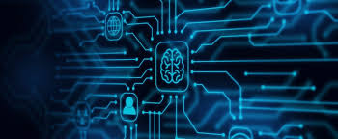
MODEL TRAINING

Slide 16
MODEL TRAINING
To identify the best-performing model for Arabic Sign Language classification, we trained four different machine learning models:
Support Vector Machine (SVM)
Random Forest
K-Nearest Neighbors (KNN)
XGBoost
For each model, we used GridSearchCV with 3-fold cross-validation to search for the optimal hyperparameters. This ensures better generalization by evaluating multiple parameter combinations.
The training was done on the PCA-transformed features, which helps reduce dimensionality and training time while preserving essential information.
Each model's best parameters, best estimator, and cross-validation score were saved for comparison.

Slide 17

MODEL EVALUATION

Slide 18
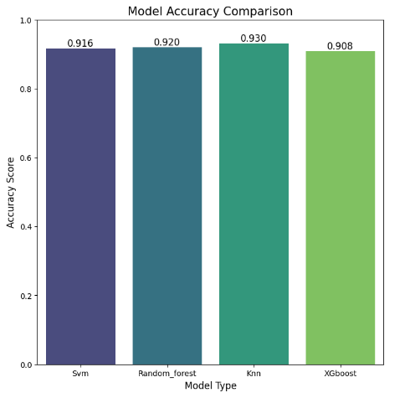
MODEL EVALUATION
After comparing all the models we used, using evalution metrics such as GridSearchCV and Cross-Validation, we reached a valuable result which was that the most accurate model to use was KNN with a score reached 0.93.
We also utilizied some viaualization to reinforce the results we got, such as:
Bar Plot was used to compare the score values of all the models we used

Slide 19
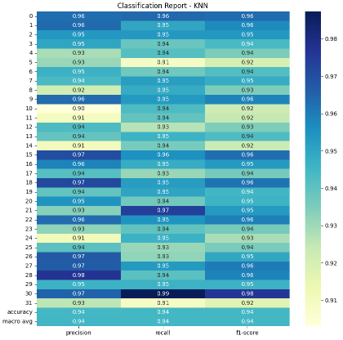
MODEL EVALUATION
After comparing all the models we used, using evaluation metrics such as GridSearchCV and Cross-Validation, we reached a valuable result which was that the most accurate model to use was KNN with a score reached 0.93.
We also utilized some visualization to reinforce the results we got, such as:
Heat maps were used twice, first to represent the
classification report for the KNN model in a more user-friendly
way

Slide 20
MODEL EVALUATION
After comparing all the models we used, using evalution metrics such as GridSearchCV and Cross-Validation, we reached a valuable result which was that the most accurate model to use was KNN with a score reached 0.93.
We also utilizied some viaualization to reinforce the results we got, such as:
And the second time we used heatmap is to visualize the confusion matrix of the model in order also to visualize more facts and evidence about the model we trained

Slide 21
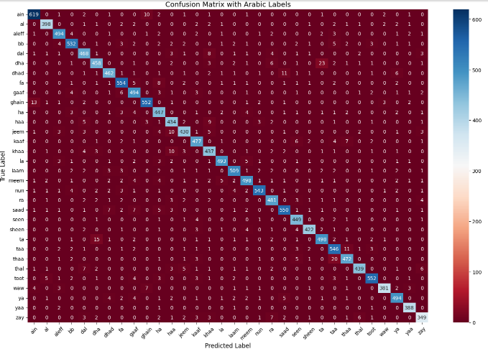
MODEL EVALUATION

Slide 22
MODEL EVALUATION
To identify the best-performing model for Arabic Sign Language classification, we trained four different machine learning models:
Support Vector Machine (SVM)
Random Forest
K-Nearest Neighbors (KNN)
XGBoost
For each model, we used GridSearchCV with 3-fold cross-validation to search for the optimal hyperparameters. This ensures better generalization by evaluating multiple parameter combinations.
The training was done on the PCA-transformed features, which helps reduce dimensionality and training time while preserving essential information.
Each model's best parameters, best estimator, and cross-validation score were saved for comparison.

Slide 23
SUMMARY
Developed an image classification model to recognize Arabic sign language letters.
Used the ArSL_Dataset from Kaggle with over 54,000 labeled images.
Applied essential preprocessing techniques including grayscale conversion, normalization, resizing, and data cleaning.
Tested several machine learning algorithms: Random Forest, SVM, KNN, XGBoost.
Evaluated models using accuracy, F1-score, confusion matrix, and cross-validation.
Random Forest Classifier achieved the highest performance with ~93% accuracy.
Used GridSearchCV to fine-tune hyperparameters and enhance model efficiency.
Visualization techniques helped in both model comparison and result interpretation.
Future improvements could involve deep learning (CNNs) and real-time gesture recognition.
This project aimed to bridge the communication gap for the hearing-impaired by developing a machine learning-based Arabic Sign Language (ArSL) recognizer. Using a rich image dataset, we built and evaluated multiple models to accurately classify Arabic sign gestures, ultimately selecting the most effective approach based on thorough testing and evaluation.

Slide 24
AND BEFORE GOODBYE
Technology should serve humanity and with this project, we hope to take one small step toward a world where communication is truly inclusive.

Slide 25
THANKS!
ANY QUESTIONS?

